Slide 1
In how many languages can you say
“I love you”? When you fall in love, isn’t it cool to have your Lover saying love words in your language? What do you think?
ASAAD Zeinab
MARIE Bruno

Slide 2
Now…
How can you say “kiss me” in different Romance languages?

Slide 3
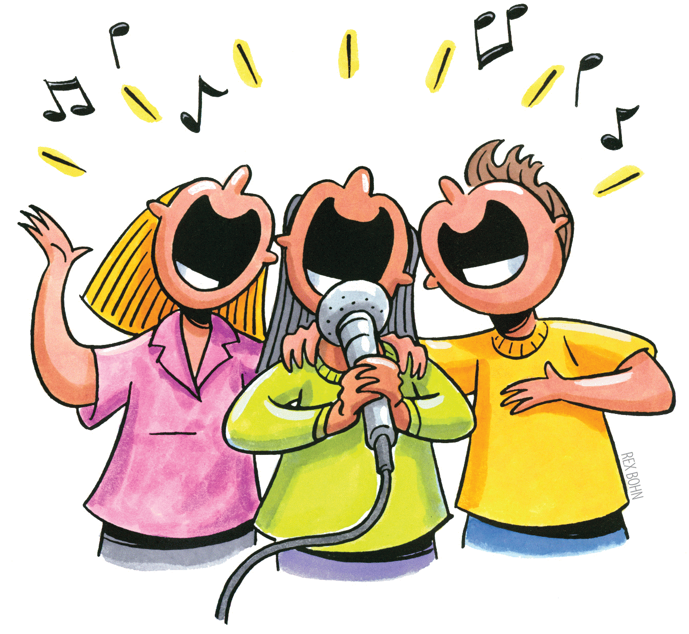
Besame Mucho in which languague do you know it?

Slide 4
In which language this text is written?
Bésame, bésame mucho
Que tengo miedo a perderte, perderte después Quiero sentirte muy cerca
Mirarme en tus ojos
Verte junto a mi
Piensa que tal vez mañana
Yo ya estaré lejos
Muy lejos de ti
Language:

Slide 5
In which language this text is written? Have you noticed some similarities with other languages? Try to identify these words
Bésame, bésame mucho
Que tengo miedo a perderte, perderte después Quiero sentirte muy cerca
Mirarme en tus ojos
Verte junto a mi
Piensa que tal vez mañana
Yo ya estaré lejos
Muy lejos de ti

Slide 6
In which language theses texts are written?
E con la bocca gia' bianca, col cuore che manca mi senti implorar
besame, besame mucho baciami come in un ultimo bacio d'amorPensa che tutta la vita tu sei per me. Poi, tutta nuova, sorridimi e baciami ancor. Pensa che tutta la vita tu sei per me...
Oui je sais bien qu'un beau jour on revient
Mais j'hésite ce jour est si loin
N'y croyons pas
Disons nous toi et moi
Qu'on se voit pour la dernière fois
Donne moi
Donne-moi vite
Tant de baisers mon amour
Language:
Language:

Slide 7
In which language theses texts are written?
Beija-me, me beije muito
Que tenho medo de te perder, te perder depois
Quero te ter muito perto
Olhar em teus olhos e estar junto contigo
Pensa que tal vez amanhã
Estarei muito longe, muito longe daqui
Language:

Slide 8
In which language theses texts are written? Have you noticed some similarities with other languages? Try to identify these words
E con la bocca gia' bianca, col cuore che manca mi senti implorar
besame, besame mucho baciami come in un ultimo bacio d'amor Pensa che tutta la vita tu sei per me. Poi, tutta nuova, sorridimi e baciami ancor. Pensa che tutta la vita tu sei per me...
Oui je sais bien qu'un beau jour on revient
Mais j'hésite ce jour est si loin
N'y croyons pas
Disons nous toi et moi
Qu'on se voit pour la dernière fois
Donne moi
Donne-moi vite
Tant de baisers mon amour

Slide 9
In which language theses texts are written?
Beija-me, me beije muito
Que tenho medo de te perder, te perder depois
Quero te ter muito perto
Olhar em teus olhos e estar junto contigo
Pensa que tal vez amanhã
Estarei muito longe, muito longe daqui

Slide 10
Try to find the missing verb or noun
Spanish | Italian | French | Portuguese | English
 | molto | beaucoup | muito | much
Besame | Baciami | Embrasse-moi |  | Kiss me
beso | bacio |  | beijo | kiss
 | perdersi | Se perdre | Se perder | Get lost
sentirte |  | te sentir | Sinto vecô | Feel you
 | occhi | Les yeux (un oeil) | olhos | eyes
verte | ci vediamo |  | Te vejo | To see you
piensa | pensare | penser |  | think
 | lo sarò | Je serai | Eu serei | I will be
amor |  | amour | amor | love

Slide 11
Try to find the missing verb or noun
Spanish | Italian | French | Portuguese | English
mucho | molto | beacoup | muito | much
Besame | Baciami | Embrasse-moi | Beija-me | Kiss me
beso | bacio | baiser | beijo | kiss
perderte | perdersi | Se perdre | Se perder | Get lost
sentirte | sentirti | te sentir | Sinto vecô | Feel you
ojos | occhi | les yeux (un oeil) | olhos | eyes
verte | ci vediamo | te voir | Te vejo | To see you
piensa | pensare | penser | pensar | think
estaré | lo sarò | Je serai | Eu serei | I will be
amor | amore | amour | amor | love

Slide 12
Each language with its colour
Spanish | Italian | French | Portuguese | English
mucho | molto | beacoup | muito | much
Besame | Baciami | Embrasse-moi | Beija-me | Kiss me
beso | bacio | baiser | beijo | kiss
perderte | perdersi | Se perdre | Se perder | Get lost
sentirte | sentirti | te sentir | Sinto vecô | Feel you
ojos | occhi | les yeux | olhos | eyes
verte | ci vediamo | te voir | Te vejo | To see you
piensa | pensare | penser | pensar | think
estaré | lo sarò | Je serai | Eu serei | I will be
amor | amore | amour | amor | love

Slide 13
I love you English
Te amo español
Ti amo Italiano
Eu te amo Português
Je t’aime français

Slide 14
The class is going to be separated in work groups (duos, trios,…)
Each group has one colour
Orange
Yellow
Light green
Dark green
Light blue
Dark blue

Slide 15
Each group has to choose tWo versions of the song and compare them
Spanish-French
Spanish-Italian
Spanish-Portuguese
French-Italian
French-Portuguese
Italian-Portuguese
Each group will have to produce a Poster answering to the following instructions…

Slide 16
In your work group:
Each version of the song is different,
Try to find the main differences between the stories in the two versions you have.
Write down a list of words where you see these differences.
Write down whether these words are verbs, nouns or something else Can you think of an equivalent in the other language?

Slide 17
In your work group:
Write everything on your poster
Hang your poster on the classroom wall

Slide 18
You’re going to compare your works, so each group is going to separate in three new groups where there will be at least one person per colour:
Spanish-French
Spanish-Italian
Spanish-Portuguese
French-Italian
French-Portuguese
Italian-Portuguese
This is called the Jigsaw method

Slide 19
Each multicolored group will go from a poster to another.
At each poster,
The person who has worked on it will explain what has been found to the others
The others will examine what has been found and may ask questions or propose changes
The person who has worked on the poster will write down possible changes
This will go on till Each multicolored group will have seen every poster.

Slide 20
Everybody goes back in the original groups
Spanish-French
Spanish-Italian
Spanish-Portuguese
French-Italian
French-Portuguese
Italian-Portuguese
Now tell each others what has been said about your poster and make changes if necessary

Slide 21
Reflective analysis Everybody talks about what they learned
What have you learned in these activities?
Now, can you tell “Kiss me” in other Romance languages?
What have you thought about the Jigsaw methode? Did you get interesting results?
Do you have questions?

Slide 22
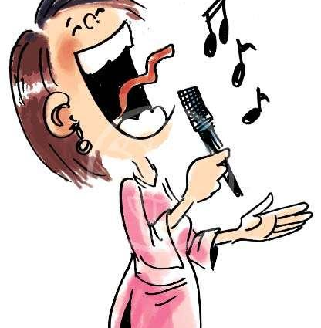
Choose the version you liked the most and start singing

